Slide 1
Coding is Fun 6
How Cool Can You Get?

Slide 2
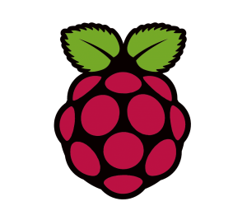
Raspberry Pi
www.raspberrypi.org
Cheap – under £30
Needs a few extras!

Slide 3
Raspberry Pi
Motherboard
Processor
CPU
GPU
Memory (RAM)
Connectors – peripherals
Storage – SD Card – NOT a Hard Disc
Keyboard, Mouse
Display
Network
Power
Others – GPIO (like the PIC)

Slide 4
What’s This All About?
Buzz
Rex
Bo
Hamm
Slink
Potato
Woody
Sarge
Etch
Lenny
Squeeze
Wheezy

Slide 5
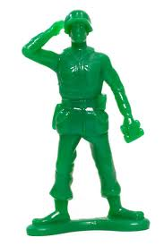
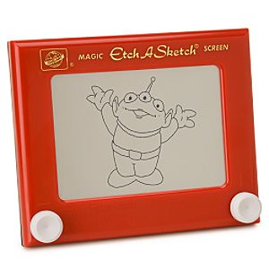
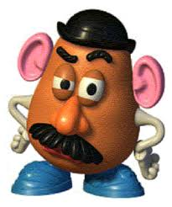
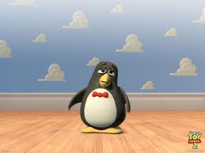
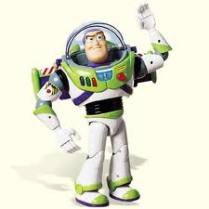
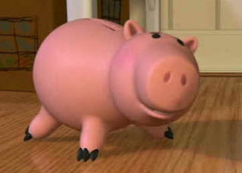
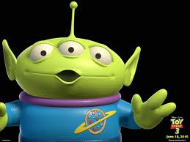
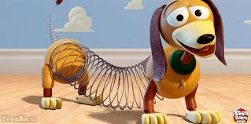
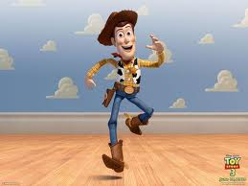
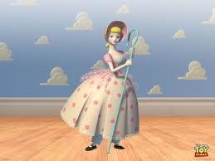
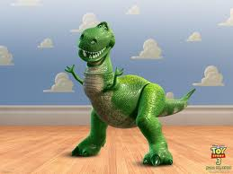
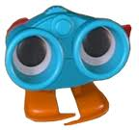
A Hint!

Slide 6
And These?
Cupcake
Donut
Éclair
Froyo
Gingerbread
Honeycomb
Ice Cream Sandwich
Jelly Bean

Slide 7
Or These?
Kodiak
Cheetah
Puma
Jaguar
Panther
Tiger
Leopard
Snow Leopard
Lion
Mountain Lion

Slide 8
Operating Systems
Linux (Debian, Ubuntu, Red Hat etc.)
Android
OS X
iOS
Windows
Raspberry Pi Linux, Debian, Squeeze

Slide 9
Computers
Hardware
Motherboard
Processor – CPU / GPU
Memory (RAM)
Storage
Peripherals
Software
Operating System
Applications

Slide 10
Programming
Integrated Development Environment (IDE)
MPLAB – for PIC
Eclipse – for Android
Visual Studio – for Windows
Geany – for Raspberry Pi
An Application For Creating Applications

